Slide 1
— Students: F. Minutella | A Schiavo | M. Daole | M. Gómez ||
Sketches Recognition
Professors: C. Gennaro | F. Falchi | G. Amato | P. Bolettieri —

Slide 2
Project Description
Implement index LSH to allow fast similarity search on deep features and create an image search engine on top of it
Use the pre trained Deep Neural Network Inception to extract features from the dataset Sketches and the distractor MirFlickr
Index the extracted features using your search engine
Measure the retrieval performance of the image search engine
Fine tune the Inception for Sketches
Use the fine tuned Inception to extract features from Sketches and MirFlickr
Index the new extracted features using your search engine
Measure the retrieval performance of the image search engine using the new features
Compare the performance of the two features
Optional:
Build a web based user interface for your web search engine

Slide 3

Our goal is to train machines to recognize and generalize abstract concepts in a manner similar to humans. As a first step towards this goal, we train our model on a dataset of hand-drawn sketches.

Slide 4
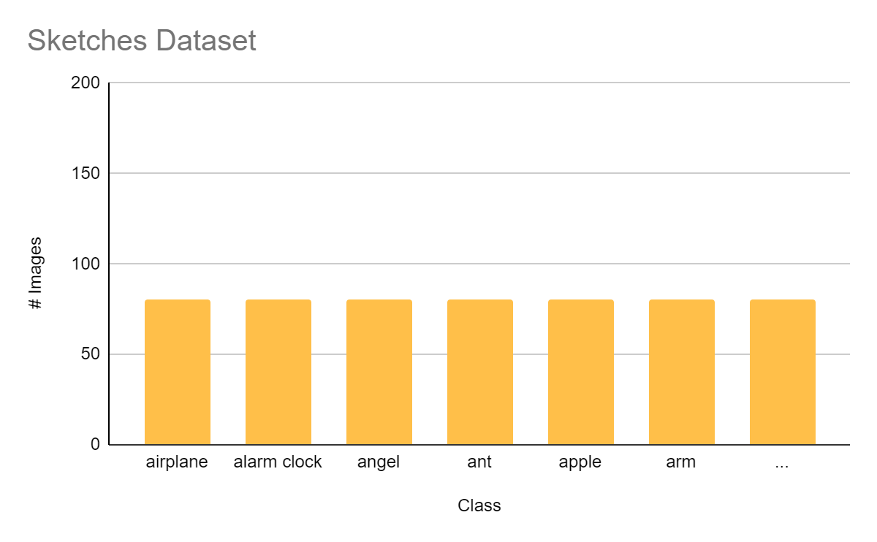
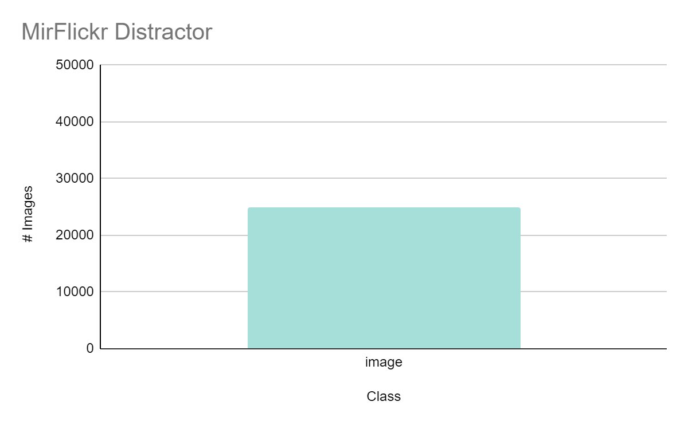
Distribution of our Datasets
250 Class and 20K Images
1 Class and 25K Images

Slide 5
LSH - Locality Sensitive Hashing
d2
d4
d1,d3
We don’t necessarily insist on the exact answer; instead, determining an approximate answer should suffice.
Similar Documents => Similar Hash-Code
For each document d:
Generate K-bit hash-code
Insert Document into hash-table
Collision => possible duplicate
Compare to documents in same bucket
1
2
3
4
5
6
7
8

Slide 6
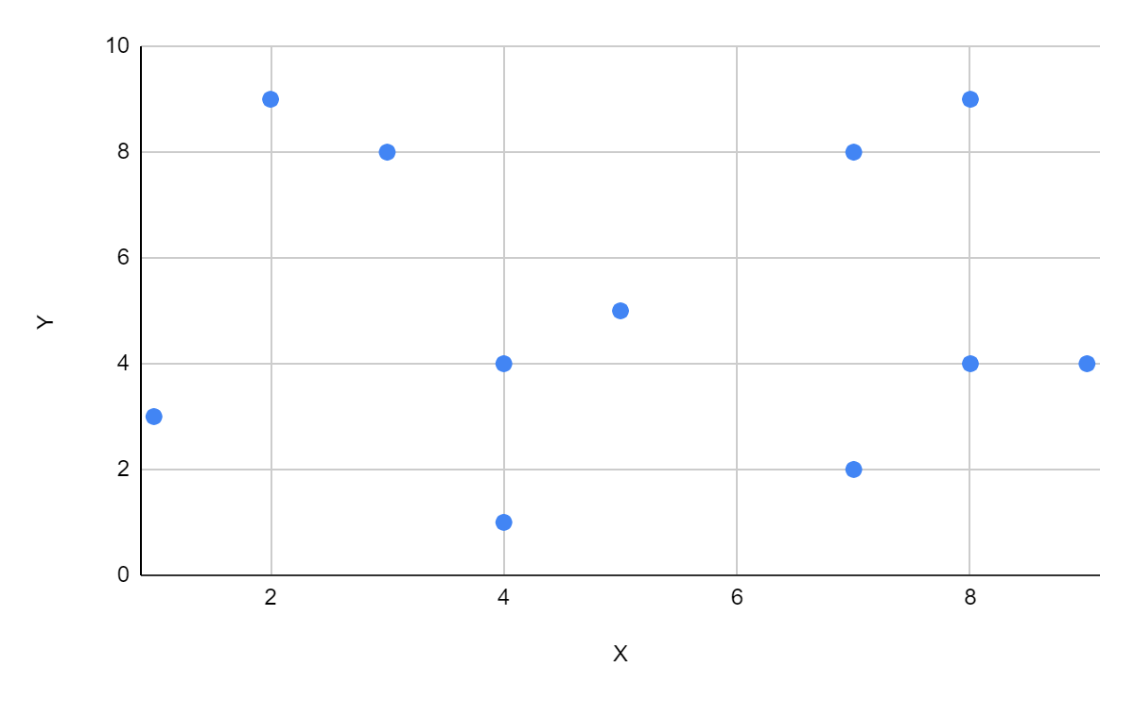
LSH - Locality Sensitive Hashing
Hash functions g() such that given any two objects p,q
If d(p,q) > c*r then Pr[g(p)= g(q)] is small
If d(p,q) ≤ r then Pr[g(p) = g(q)] is not so small
Definition: g(p)=<h₁ (p),h₂ (p),...,h _{k}(p),>
Where: h_{i} (p)=└(p*X_{i}+b_{i})/w)┘
We compare x only to training points in the same region R
x
Inexact: missed neighbors
- Repeat with different h₁ ,h₂ ,...,h_{k}
Notes:
Random Hyper plane h1 …. Hk
- Space sliced into 2^k regions (polytopes)
We compute a detailed metric for many different orientations and configurations of an object we wish to recognize.
Then, given a new image we simply check our database to see if a precomputed object's metrics are close to our query.
Compare

Slide 7
LSH - Implementation
d2
d4
d1,d3
Preprocessing: Hash function selecting <g₁ ,g₂ ,...,g_{L}>
Insertion: Any point p Insert into L buckets <g₁(p), g₂ (p),...,g_{L}(p)>
Query execution: With the query q retrieve all point from L buckets g₁(q) and reorder according to the original distance function
1
2
3
4
5
6
7
8

Slide 8
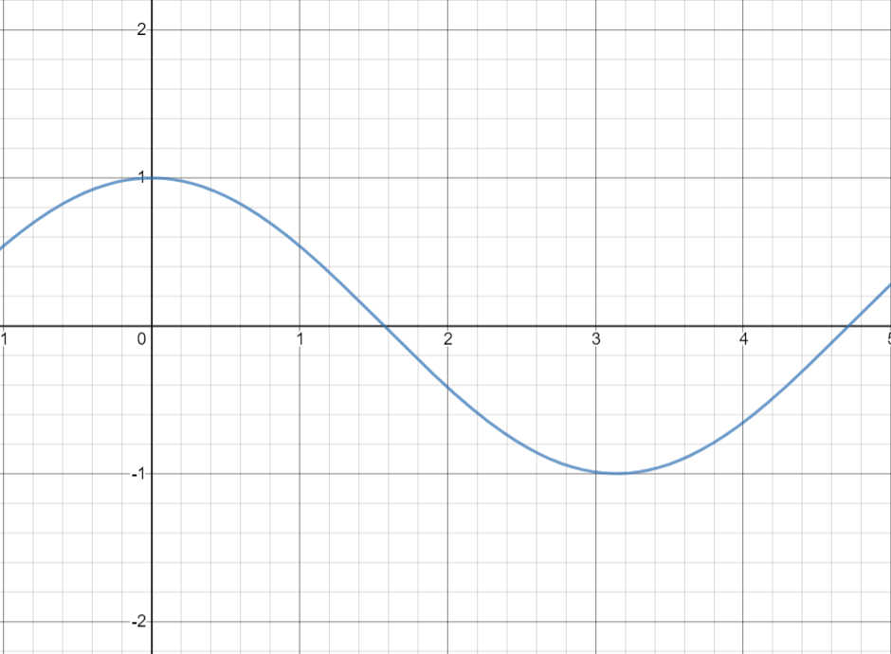
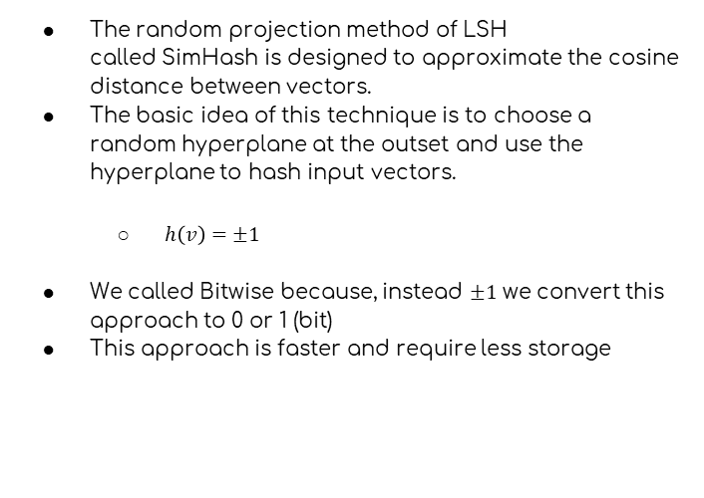
LSH – Bitwise
The random projection method of LSH called SimHash is designed to approximate the cosine distance between vectors.
The basic idea of this technique is to choose a random hyperplane at the outset and use the hyperplane to hash input vectors.
$h\left(v\right)=±1$
We called Bitwise because, instead $±1$ we convert this approach to 0 or 1 (bit)
This approach is faster and require less storage

Slide 9

No Index Structure – Test
Inside the project, we create an index with the same function structure of the LSH Index for test comparations.
Why we do that ?
Our idea was use the same structure of our LSH index, without use the computational complexity of an index. This, for search without index.
We create a set of test with an exact index (No Index Structure) and after compare the results with an LSH index

Slide 10
Features Extraction
Feature Extraction using the pretrained convolutional base
01
02
03
04
Create a image normalization preprocess with our images
Loading the pretrained DNN
Extract of the features
The result is our feature vector

Slide 11
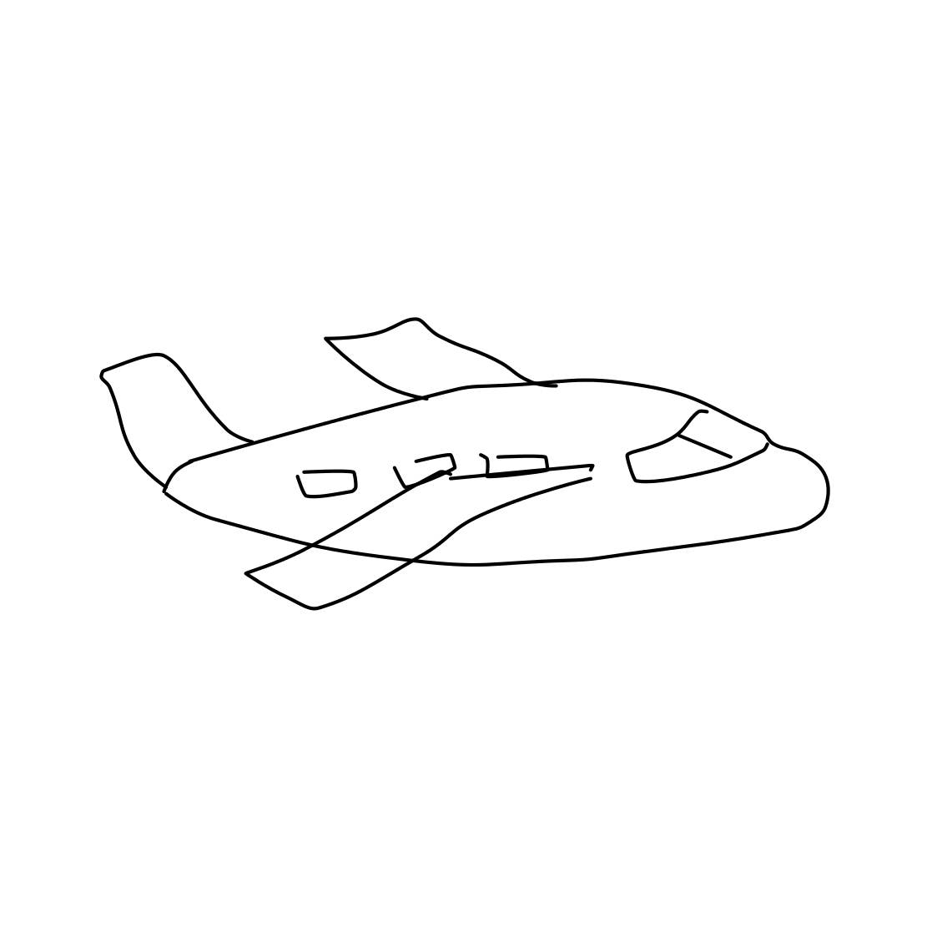
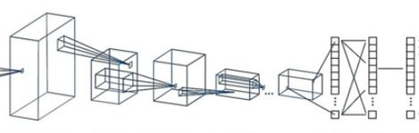

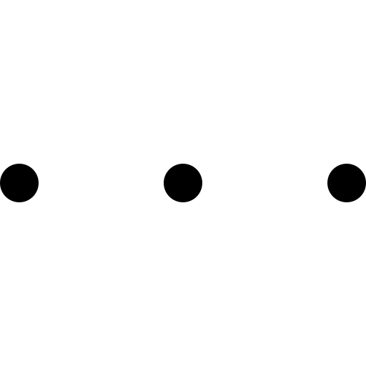
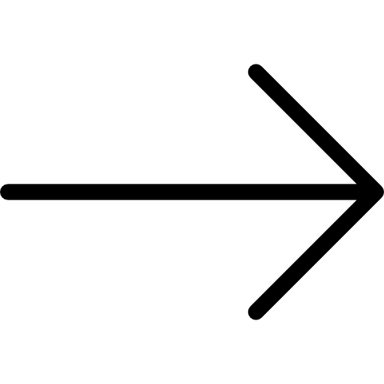
High Level Architecture
299
299
2048
Input Image
Features Extraction
LSH Index

Slide 12
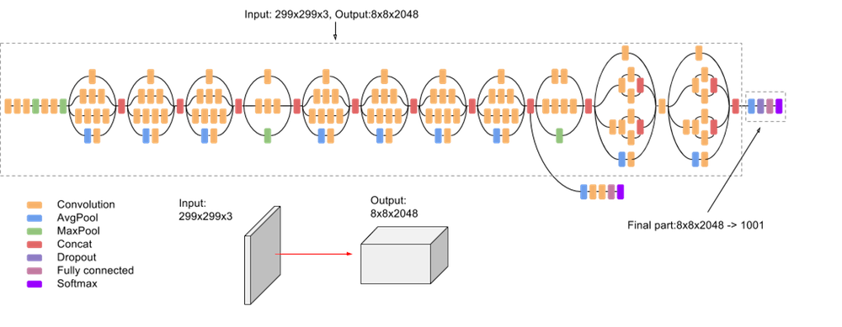
Inception V3
Have a very important milestone in the development of CNN classifiers.
The fundamental idea behind the Inception Neural Network is the inception block
Intermediate Classifiers to solve Vanishing Gradient.
Notes:
In a traditional neural network you take the output of the previous layer and that would be input to the next layer and it wourl follow that pattern all the way until the prediction
But, the inception block takess apart the individual layers and instead of just passing it through one layer it takes the previous layer input and passes it to four different operations in parallel and then concatenates the outputs for more different layers

Slide 13
Model Test and Performance
Model name | Train |  | Test |  | Euclidean mAP on train | Cosine mAP on train | Euclidean mAP using test | Cosine mAP using test
 | Loss | Accuracy | Loss | Accuracy
Model 1 | 1.2724 | 0.6617 | 1.2328 | 0.6648 | 0.1452 | 0.1687 | 0.0763 | 0.0821
Model 2 | 1.1013 | 0.7005 | 1.1035 | 0.6986 | 0.2336 | 0.3150 | 0.2701 | 0.3035
Model 3 | 0.9033 | 0.7612 | 0.9272 | 0.7620 | 0.3035 | 0.3460 | 0.2889 | 0.3464
Model 4 (Siamese) | 0.4611 | 0.8157 | 0.8868 | 0.7373 | 0.2674 | 0.3175 | 0.2618 | 0.3264
Model 5 | 0.8940 | 0.7667 | 0.9065 | 0.7610 | 0.2896 | 0.3539 | 0.2993 | 0.3784
Model 6 | 0.6899 | 0.8087 | 1.0764 | 0.7090 | 0.4294 | 0.4711 | 0.3731 | 0.4047
Model 7 | 0.7600 | 0.7867 | 0.8022 | 0.7840 | 0.3068 | 0.4071 | 0.2935 | 0.3797

Slide 14
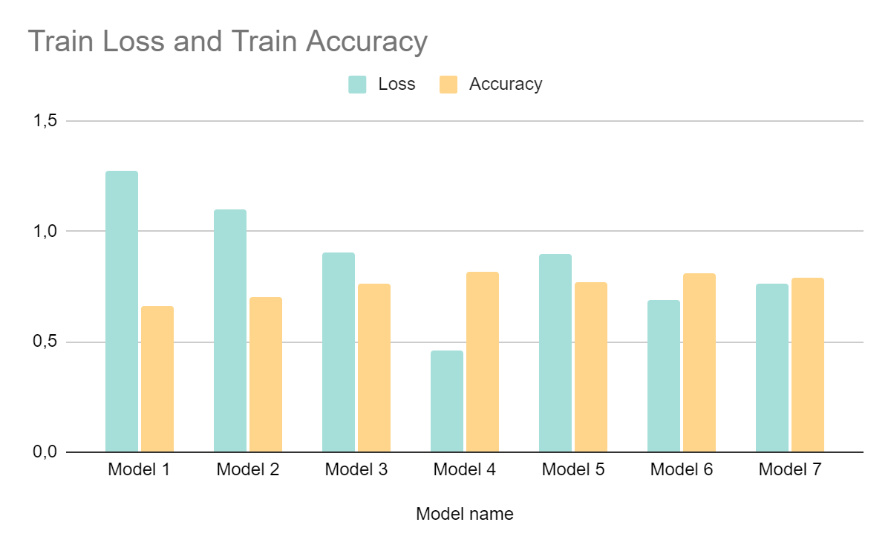
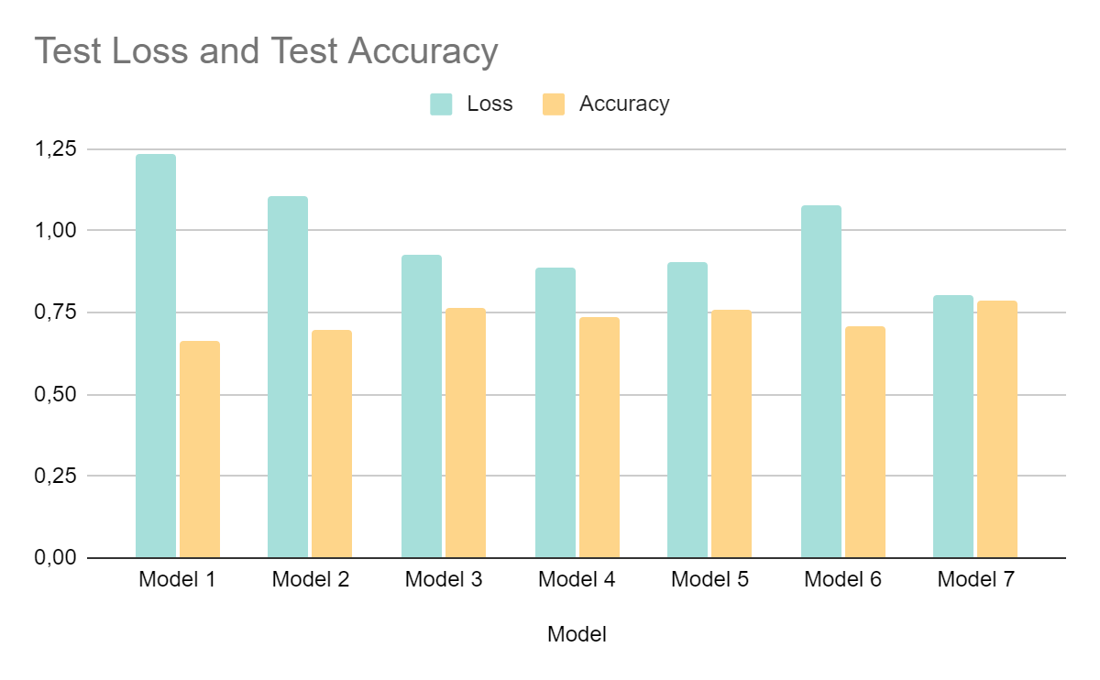
Model Test and Performance

Slide 15
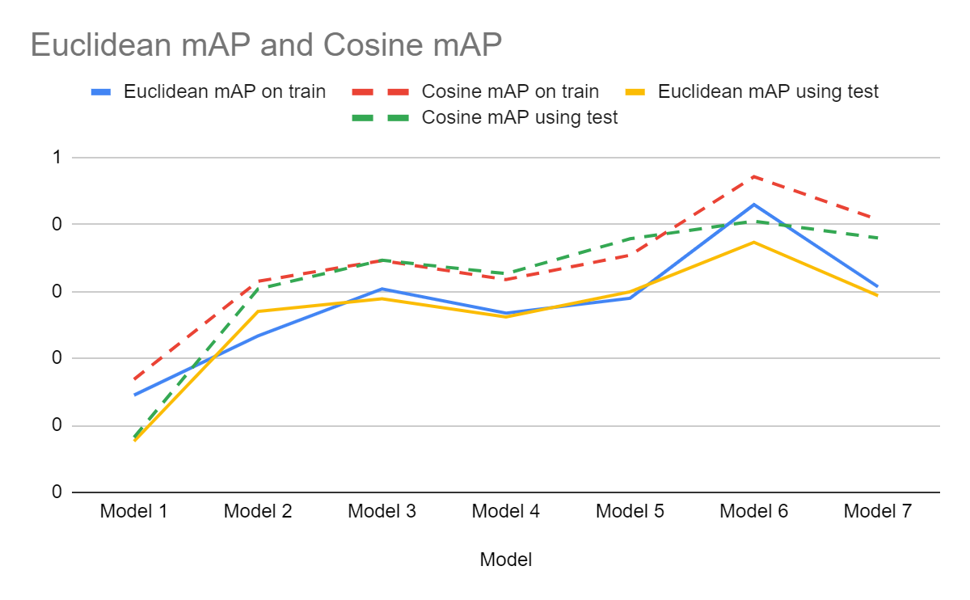
Model Test and Performance

Slide 16
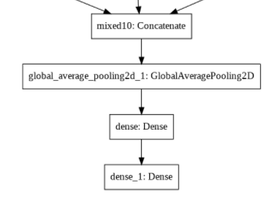
Model 1
Model with the next custom layers:
Pre-trained model Inception V3
Global spatial average pooling layer
First fully connected layer with 1024 dimensionality
Second fully connected layer with 250 dimensionality
Return
Notes:
inception_finetuning_classification

Slide 17
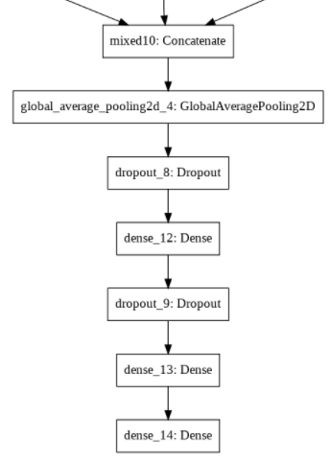
Model 2
Model with the next custom layers:
Pre-trained model Inception V3
Global spatial average pooling layer
First droupout layer with a fraction of 0.5 input units to drop
First fully connected layer with 2048 dimensionality
Second droupout layer with a fraction of the 0.5 input units to drop
Second fully connected layer with 2048 dimensionality
Third fully connected layer with 250 dimensionality
Return
Notes:
inception_finetuning_classification_2

Slide 18
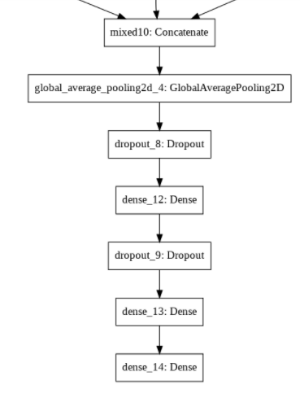
Model 3
Model with the next custom layers:
Pre-trained model Inception V3
Global spatial average pooling layer
First droupout layer with a fraction of 0.5 input units to drop
First fully connected layer with 2048 dimensionality
Second droupout layer with a fraction of the 0.5 input units to drop
Second fully connected layer with 2048 dimensionality
Third fully connected layer with 250 dimensionality
Return
Notes:
inception_finetuning_classification_2_moretrain_3

Slide 19
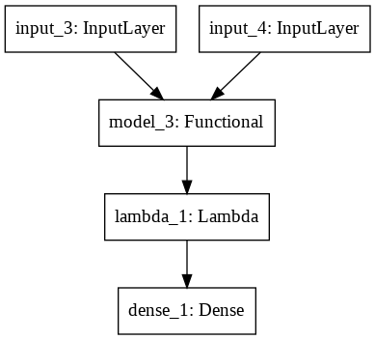
Model 4
Model with the next custom layers:
Siamese neural network with the pre-trained custom model 3
Lambda layer to compute the absolute difference between the encodings (lambda tensors:K.abs(tensors[0] - tensors[1])
First fully connected layer with 1 dimensionality with a sigmoid unit to generate the similarity score
Return
Notes:
inception_finetuning_siamese_2

Slide 20
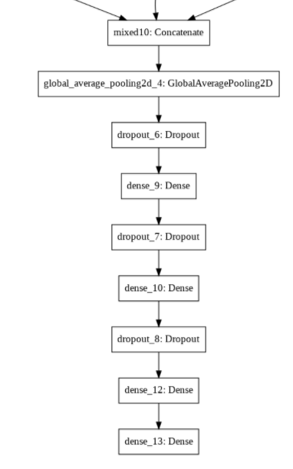
Model 5
Model with the next custom layers:
Pre-trained model Inception V3
Global spatial average pooling layer
First droupout layer with a fraction of 0.5 input units to drop
First fully connected layer with 2048 dimensionality
Second droupout layer with a fraction of the 0.5 input units to drop
Second fully connected layer with 2048 dimensionality
Second droupout layer with a fraction of the 0.5 input units to drop
Third fully connected layer with 2048 dimensionality
Fourth fully connected layer with 250 dimensionality
Return
Notes:
inception_finetuning_classification_3_last_one_more_train

Slide 21
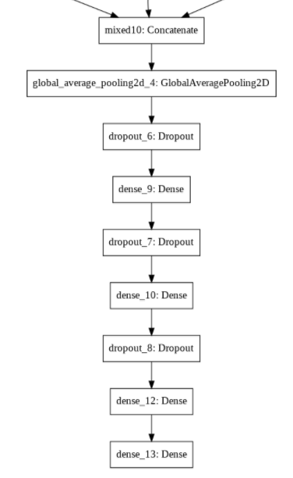
Model 6
Model with the next custom layers:
Pre-trained model Inception V3
Global spatial average pooling layer
First droupout layer with a fraction of 0.5 input units to drop
First fully connected layer with 2048 dimensionality
Second droupout layer with a fraction of the 0.5 input units to drop
Second fully connected layer with 2048 dimensionality
Second droupout layer with a fraction of the 0.5 input units to drop
Third fully connected layer with 2048 dimensionality
Fourth fully connected layer with 250 dimensionality
Return
Notes:
inception_finetuning_classification_3_last_one_more_train_all_parameters_more_train

Slide 22
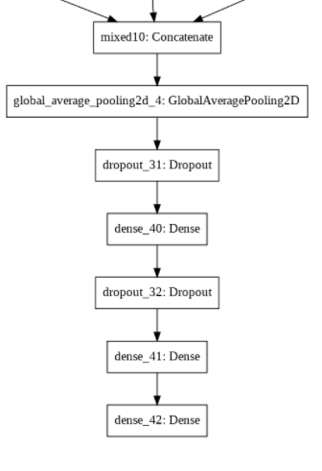
Model 7
Model with the next custom layers:
Pre-trained model Inception V3
Global spatial average pooling layer
First droupout layer with a fraction of 0.5 input units to drop
First fully connected layer with 2048 dimensionality
Second droupout layer with a fraction of the 0.5 input units to drop
Second fully connected layer with 4096 dimensionality
Third fully connected layer with 250 dimensionality
Return
Notes:
inception_finetuning_classification_dense_only_4096

Slide 23
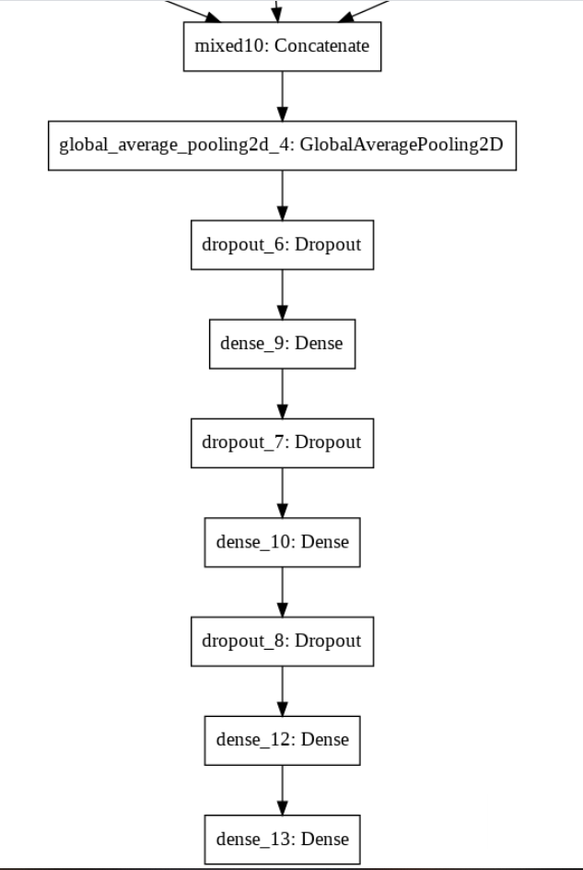
Best Model Chosen: Model 6
We choose the model with the next custom layers:
Pre-trained model Inception V3
Global spatial average pooling layer
First droupout layer with a fraction of 0.5 input units to drop
First fully connected layer with 2048 dimensionality
Second droupout layer with a fraction of the 0.5 input units to drop
Second fully connected layer with 2048 dimensionality
Second droupout layer with a fraction of the 0.5 input units to drop
Third fully connected layer with 2048 dimensionality
Fourth fully connected layer with 250 dimensionality

Slide 24
LSH Tuning (G and H)
LSH | Test mAP |  | Test IE |  | Bucket Purity AVG | Bucket Purity STD | # Buckets | # Items | # AVG per BUCKET | # STD per BUCKET
 | Euc | Cos | Euc | Cos
G = 3, H = 3 | 0,05 | 0,06 | 355 | 297 | 0,72 | 0,32 | 4885 | 120000 | 24,5 | 183,97
G = 3, H = 5 | 0,01 | 0,02 | 3441 | 3485 | 0,87 | 0,24 | 24363 | 120000 | 4,93 | 36,3
G = 4, H = 2 | 0,17 | 0,20 | 11,2 | 14,3 | 0,62 | 0,34 | 1188 | 160000 | 134,68 | 677,15
G = 5, H = 1 | 0,31 | 0,37 | 0,52 | 0,46 | 0,52 | 0,35 | 150 | 200000 | 1333,3 | 3571,97
G = 5, H = 2 | 0,19 | 0,22 | 10 | 11,81 | 0,61 | 0,35 | 1629 | 200000 | 122,77 | 642,32
G = 7, H = 2 | 0,24 | 0,26 | 5,8 | 3,9 | 0,62 | 0,34 | 2319 | 280000 | 120,7 | 722,83
G = 8, H = 2 | 0,25 | 0,27 | 1,9 | 2,69 | 0,62 | 0,35 | 2548 | 320000 | 125,59 | 688,5

Slide 25
LSH BitWise Tuning (G and H)
LSH BitWise | Test mAP |  | Test IE |  | Bucket Purity AVG | Bucket Purity STD | # Buckets | # Items | # AVG per BUCKET | # STD per BUCKET
 | Euc | Cos | Euc | Cos
G = 3, H = 1 | 0,35 | 0,42 | 0,26 | 0,26 | 0,52 | 0,27 | 6 | 120000 | 20000 | 8807
G = 3, H = 5 | 0,30 | 0,33 | 5 | 4,67 | 0,26 | 0,27 | 96 | 120000 | 1250 | 2733
G = 3, H = 6 | 0,28 | 0,32 | 8 | 8,2 | 0,3 | 0,25 | 192 | 120000 | 625 | 1502,5
G = 4, H = 4 | 0,32 | 0,39 | 1,36 | 1,37 | 0,37 | 0,32 | 64 | 160000 | 2500 | 3220,32
G = 5, H = 2 | 0,36 | 0,42 | 0,31 | 0,31 | 0,35 | 0,36 | 20 | 200000 | 10000 | 8618,35
G = 5, H = 5 | 0,31 | 0,39 | 2,23 | 2,2 | 0,29 | 0,26 | 160 | 200000 | 1250 | 2347

Slide 26
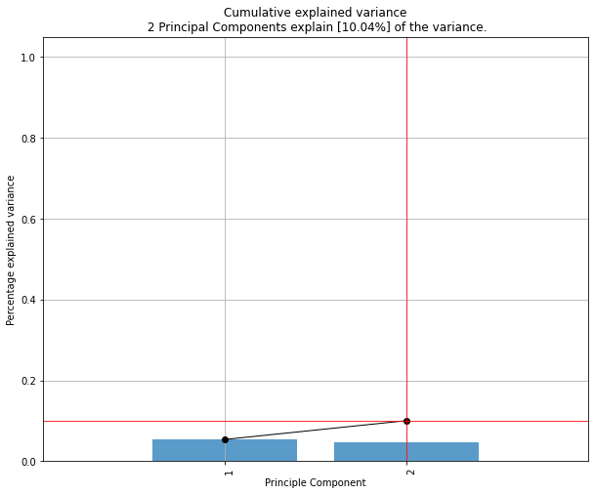
PCA - Principal Component Analysis
Is a standart techniche in the field of signal processing for data compression.
Is a linear dimensionality reduction using Singular Value Decomposition of the data to project it to a lower dimensional space.
We try it !

Slide 27
Accuracy and mAP analysis class by class
01
We create a set of query test class by class
02
For all the previous queries, we calculate the AP
03
mAP, min(AP), max(AP), std(AP), range(AP)
04
Return the Worst Sketch result and Best Sketch result

Slide 28
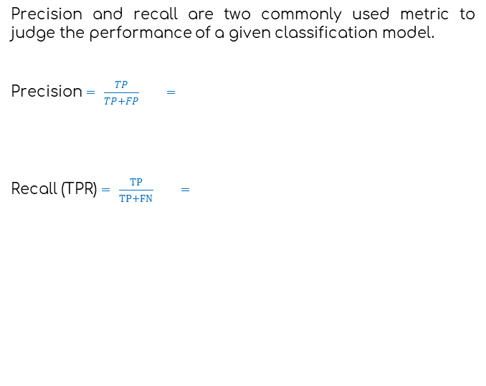
Recall
true negative
false negative
Precision and recall are two commonly used metric to judge the performance of a given classification model.
Precision = $\frac{TP}{TP+FP}$ =
Recall (TPR) = $\frac{TP}{TP+FN}$ =
true
positive
False
positive
Relevant Elements

Slide 29
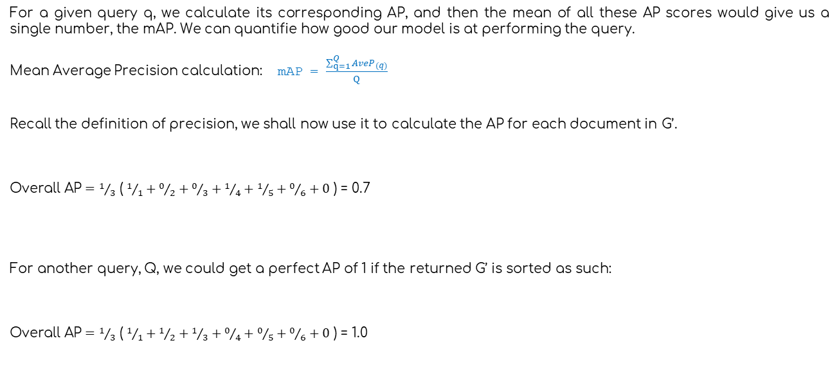
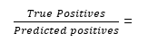
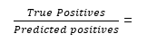
Mean Average Precision
For a given query q, we calculate its corresponding AP, and then the mean of all these AP scores would give us a single number, the mAP. We can quantifie how good our model is at performing the query.
Mean Average Precision calculation: mAP = $\frac{\sum_{q=1}^{Q}{{AveP}_{(q)}}}{Q}$
Recall the definition of precision, we shall now use it to calculate the AP for each document in G’.
$\text{Overall} \text{AP}=$ $1/3$ ( $1/1+0/2+0/3+1/4+1/5+0/6+0$ ) = 0.7
For another query, Q, we could get a perfect AP of 1 if the returned G’ is sorted as such:
$\text{Overall} \text{AP}=$ $1/3$ ( $1/1+1/2+1/3+0/4+0/5+0/6+0$ ) = 1.0
$\frac{True Positives}{Predicted positives}$ =
…
$$1/1$$
$$0/2$$
$0/$3
$$1/4$$
$$1/5$$
$0/$6
$$0/n$$
…
$\frac{True Positives}{Predicted positives}$ =
$$1/1$$
$$1/2$$
$1/$3
$0/$4
$$0/5$$
$0/$6
$0/$n

Slide 30
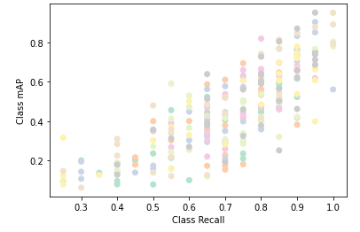
Recall Vs Mean Average Precision
Correlation coefficient:
0.7863

Slide 31
best mAP and Accuracy results
? =

Slide 32
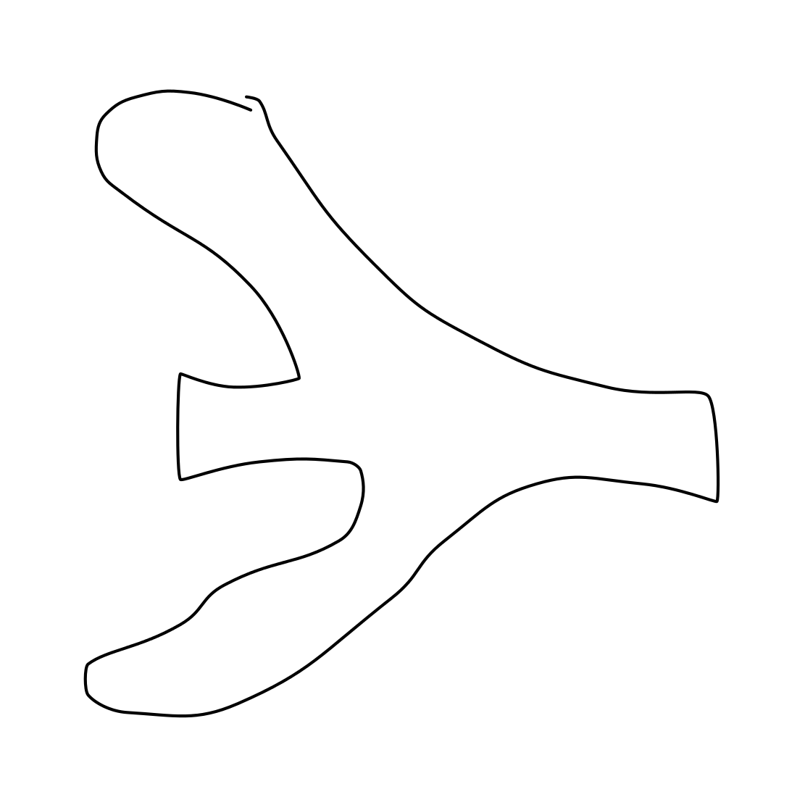
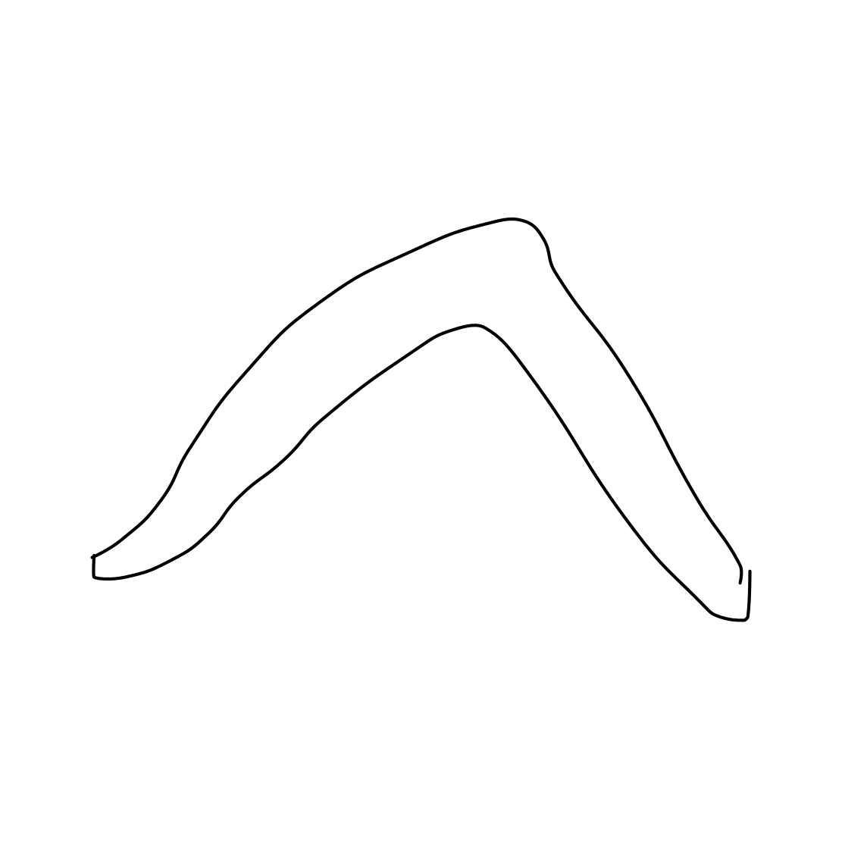
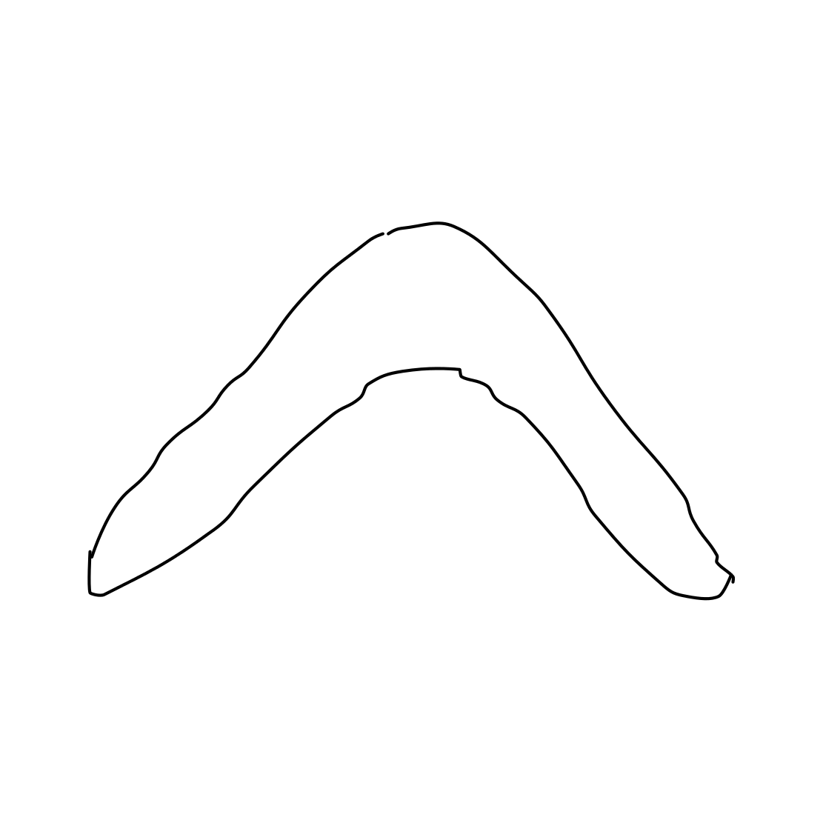
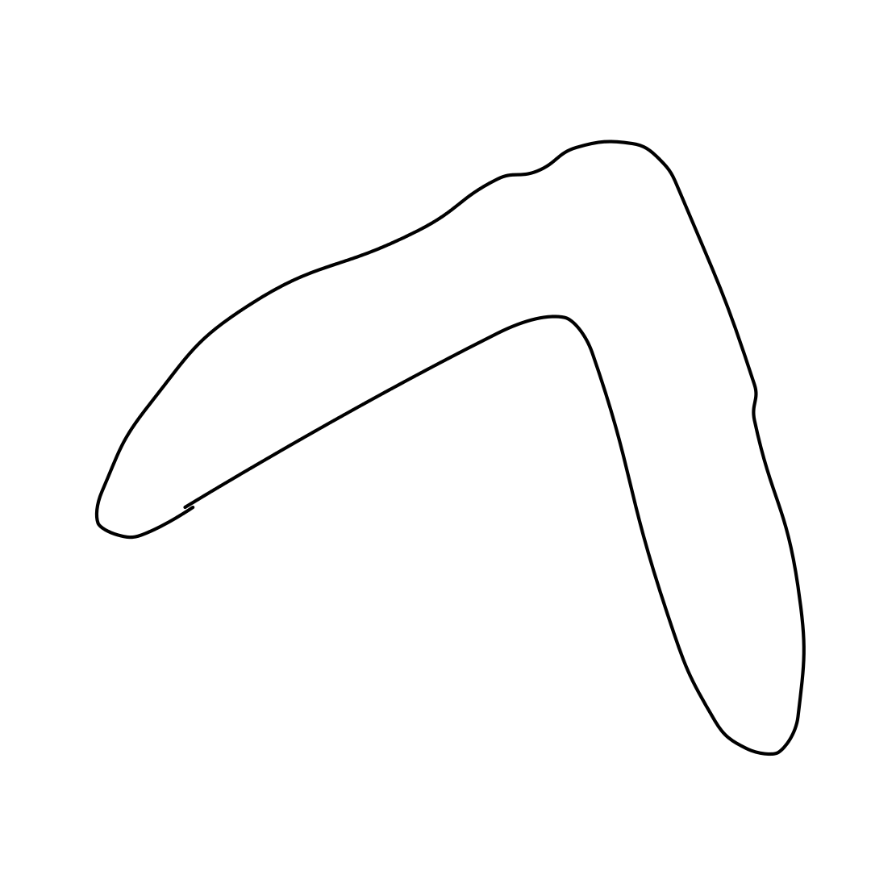
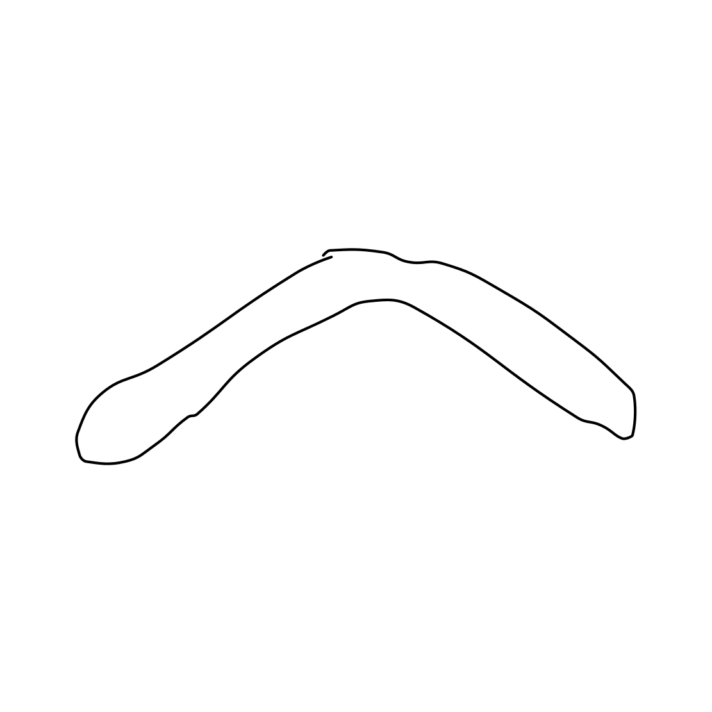
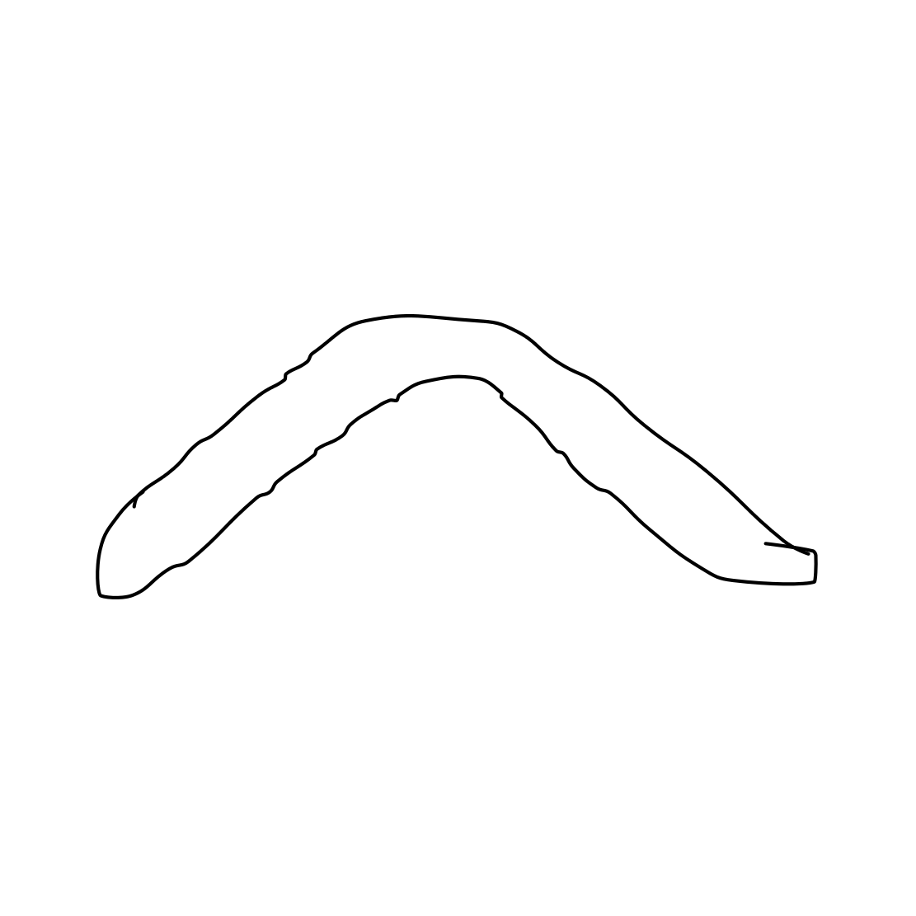
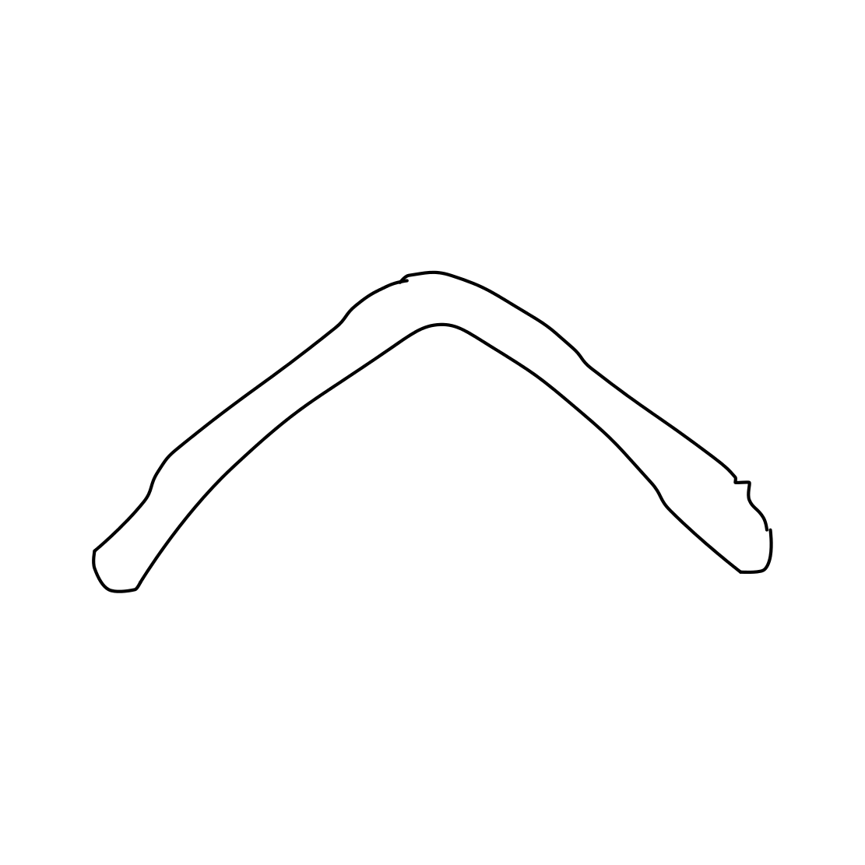
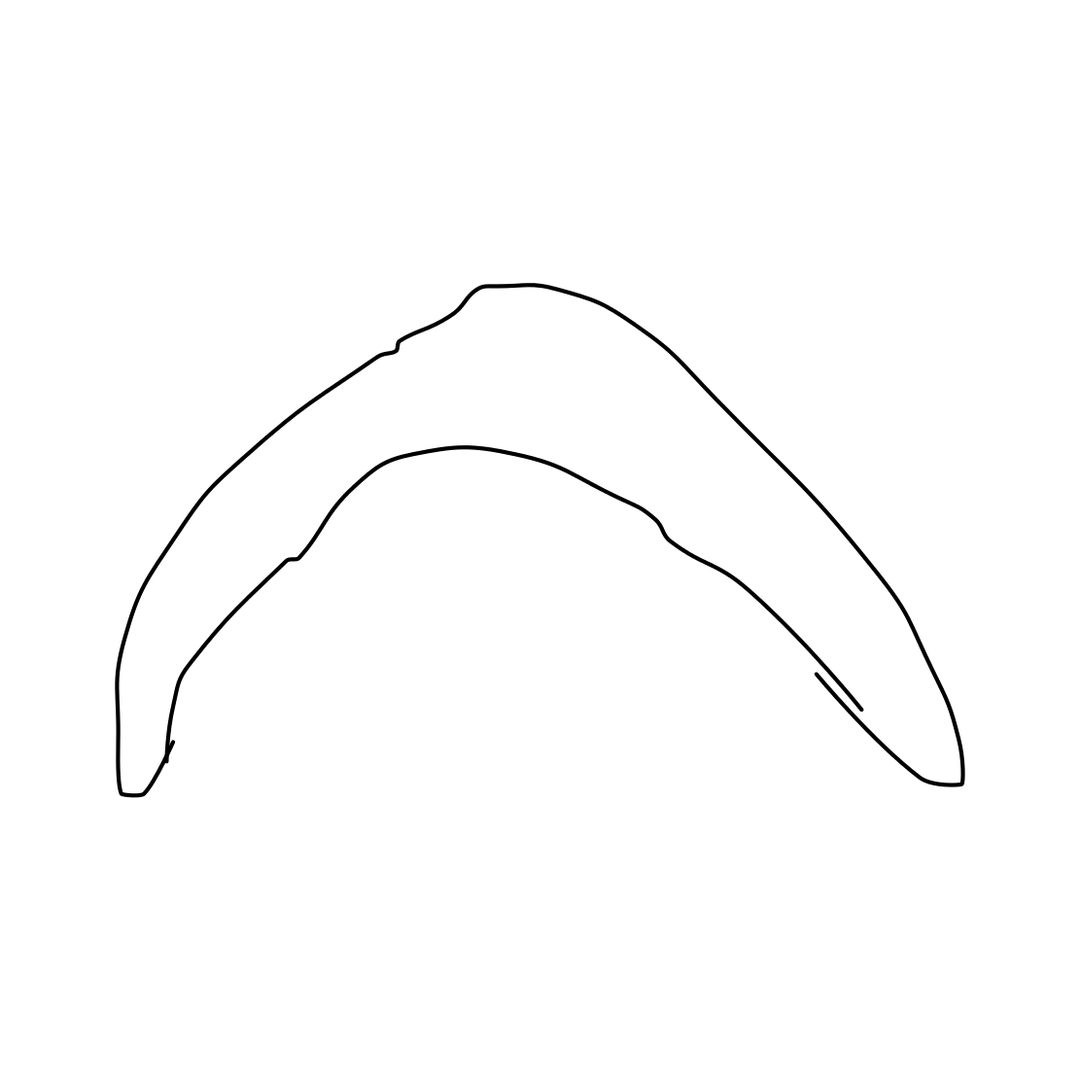


Class Boomerang: mAP 0.77 Recall 0.90
Worst sketch: AP = 0.0125
Best sketch: AP = 0.936
Some other sketches from the boomerang class:

Slide 33
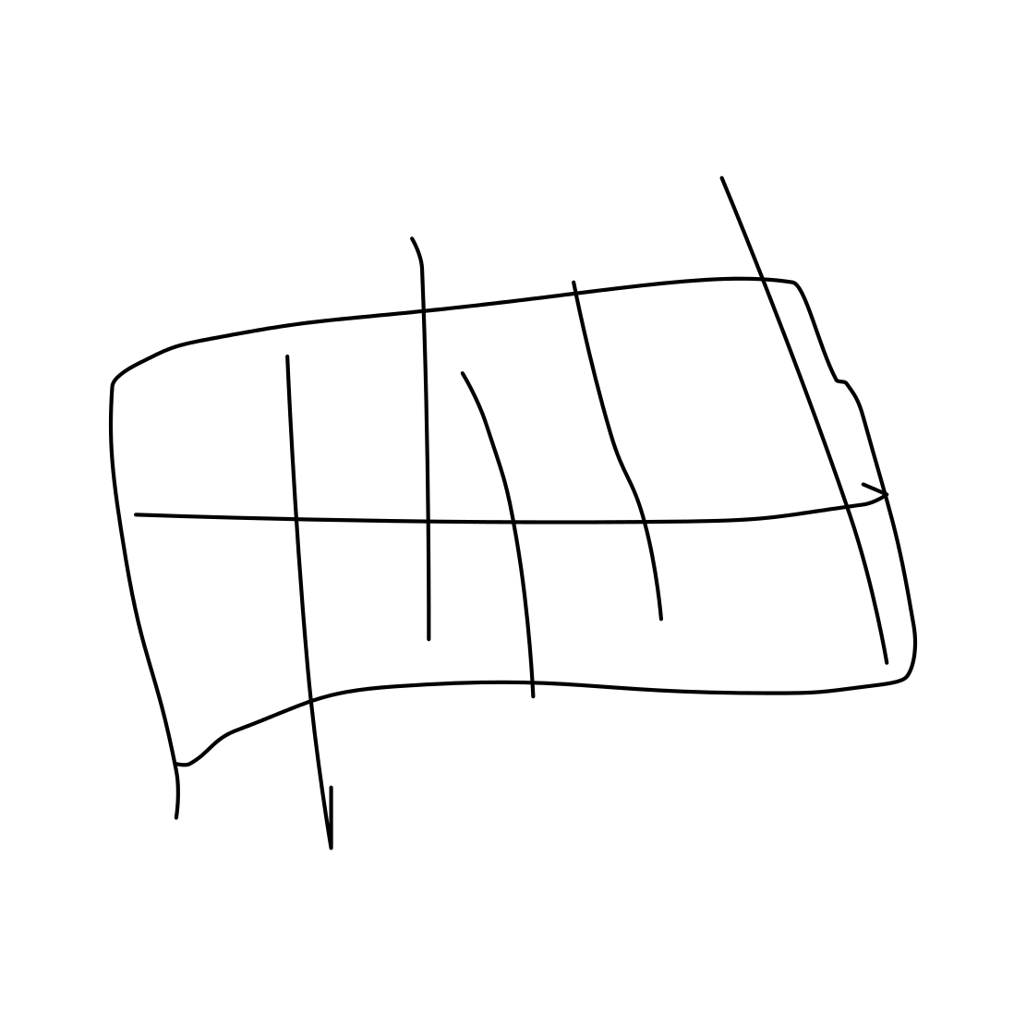
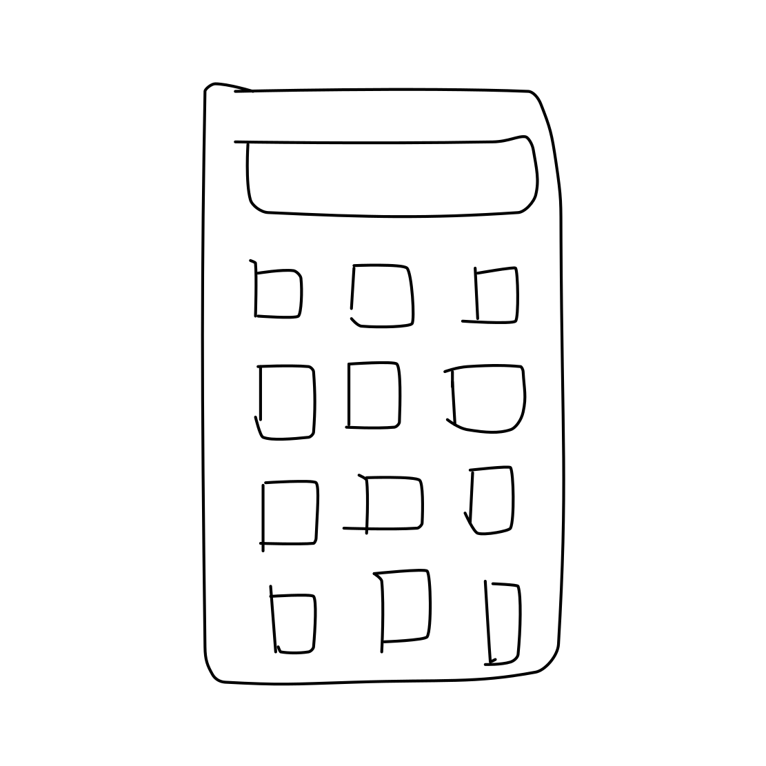
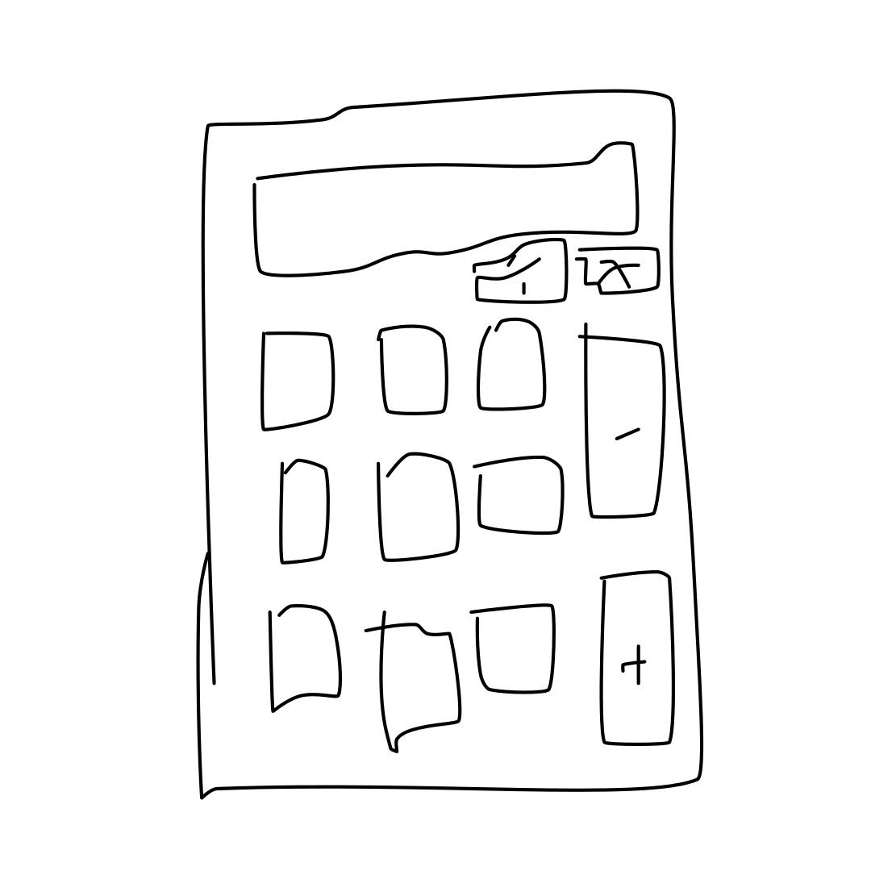
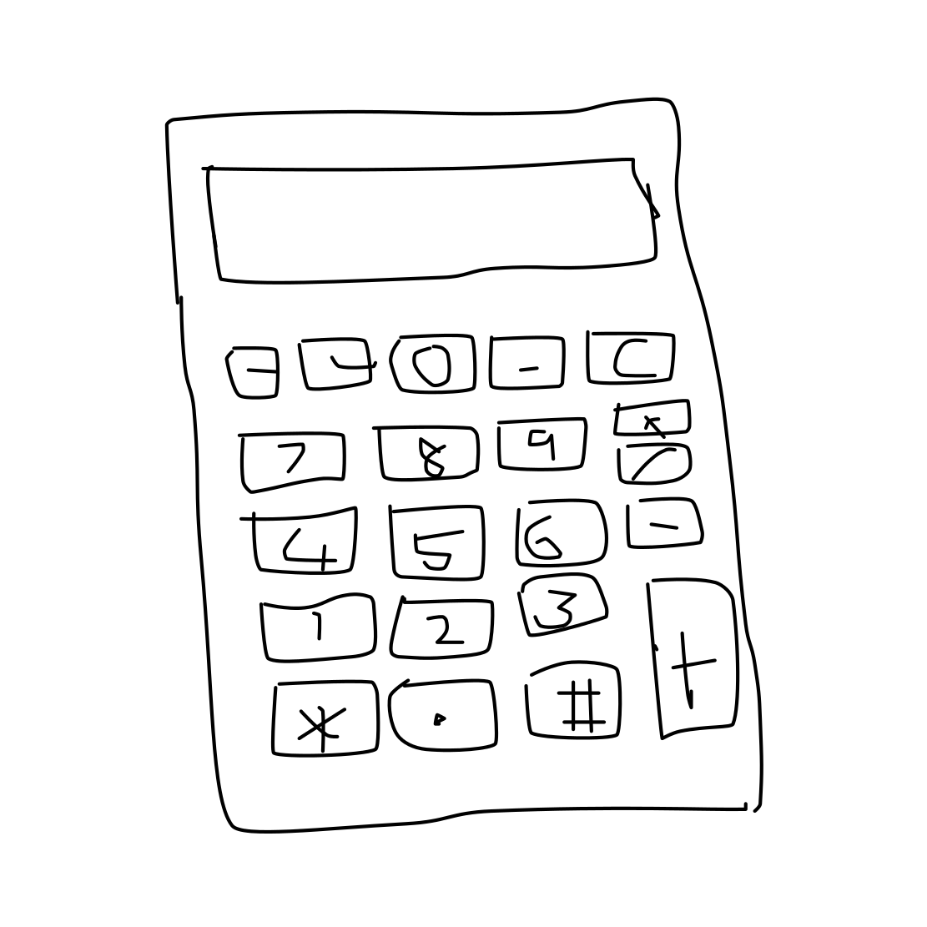
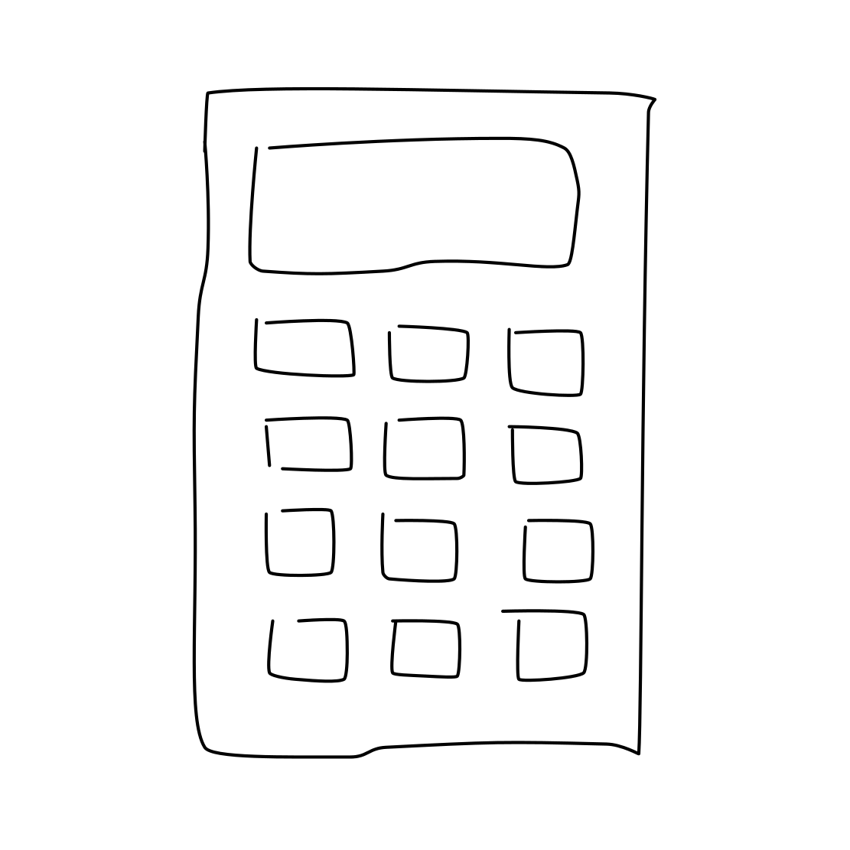
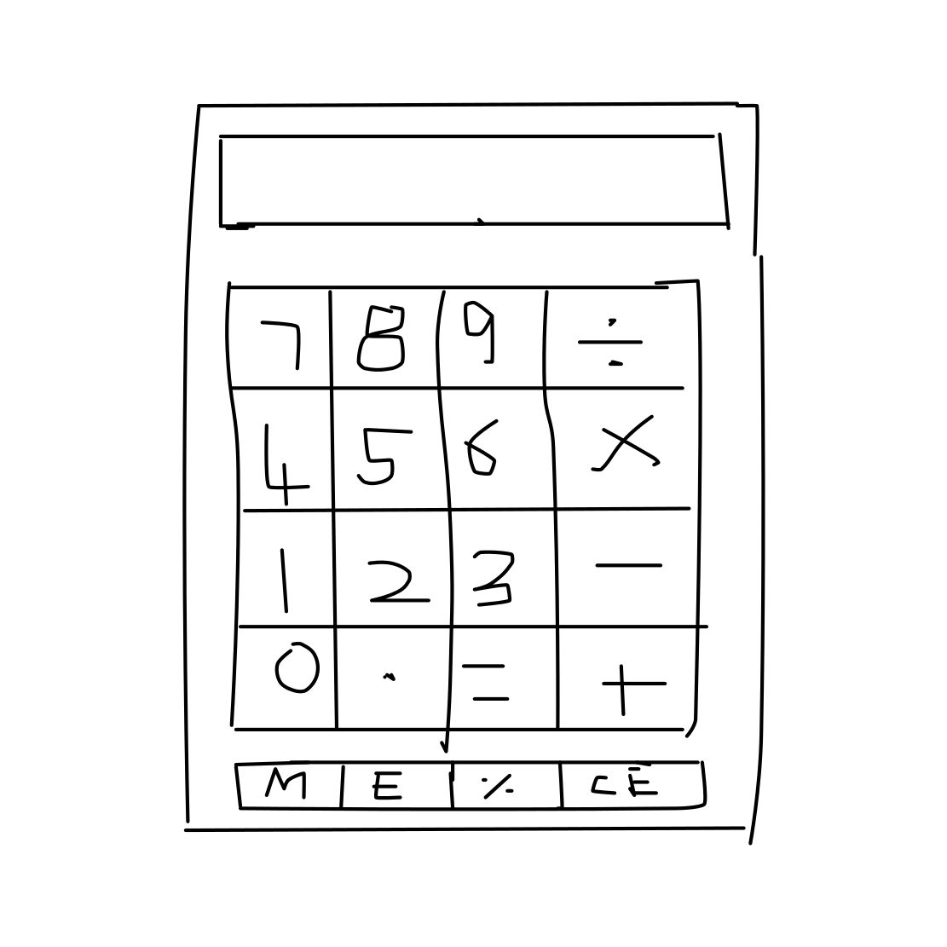
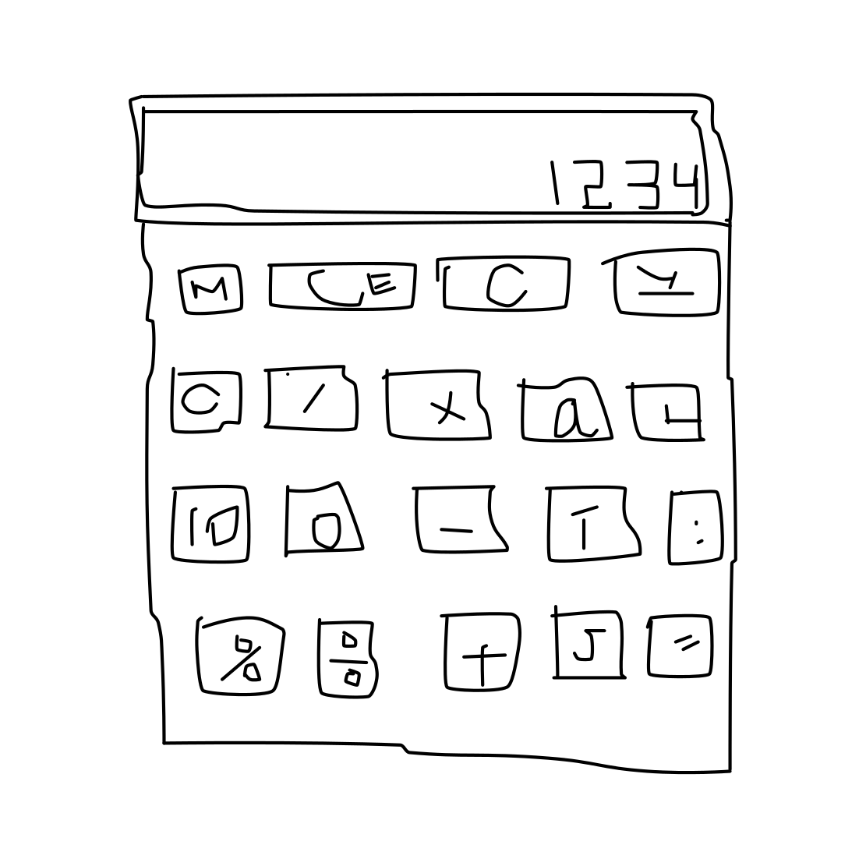
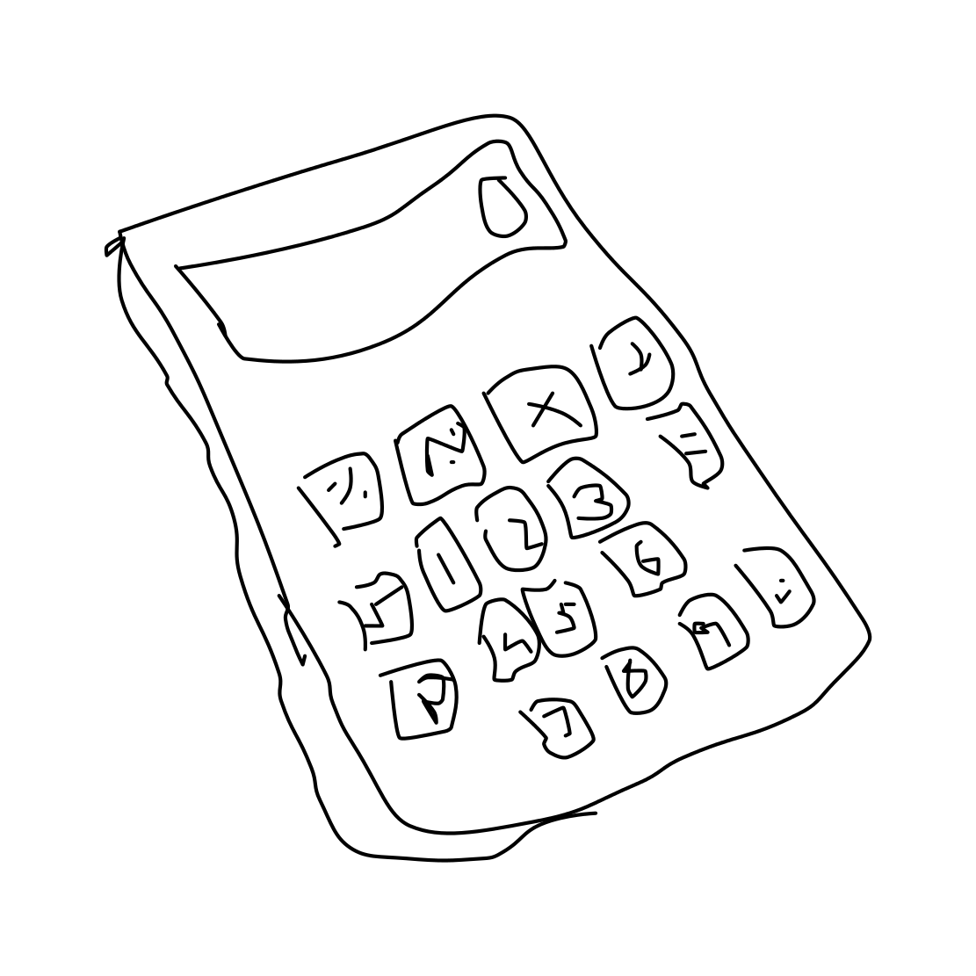
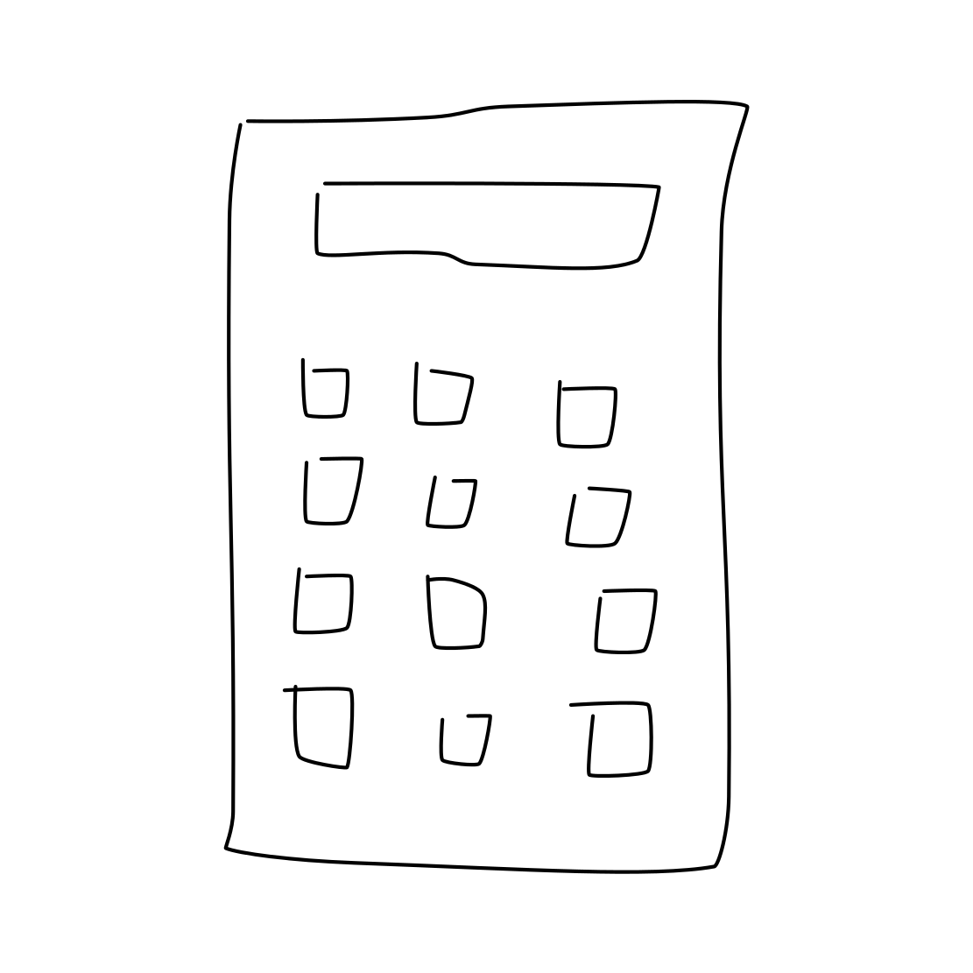
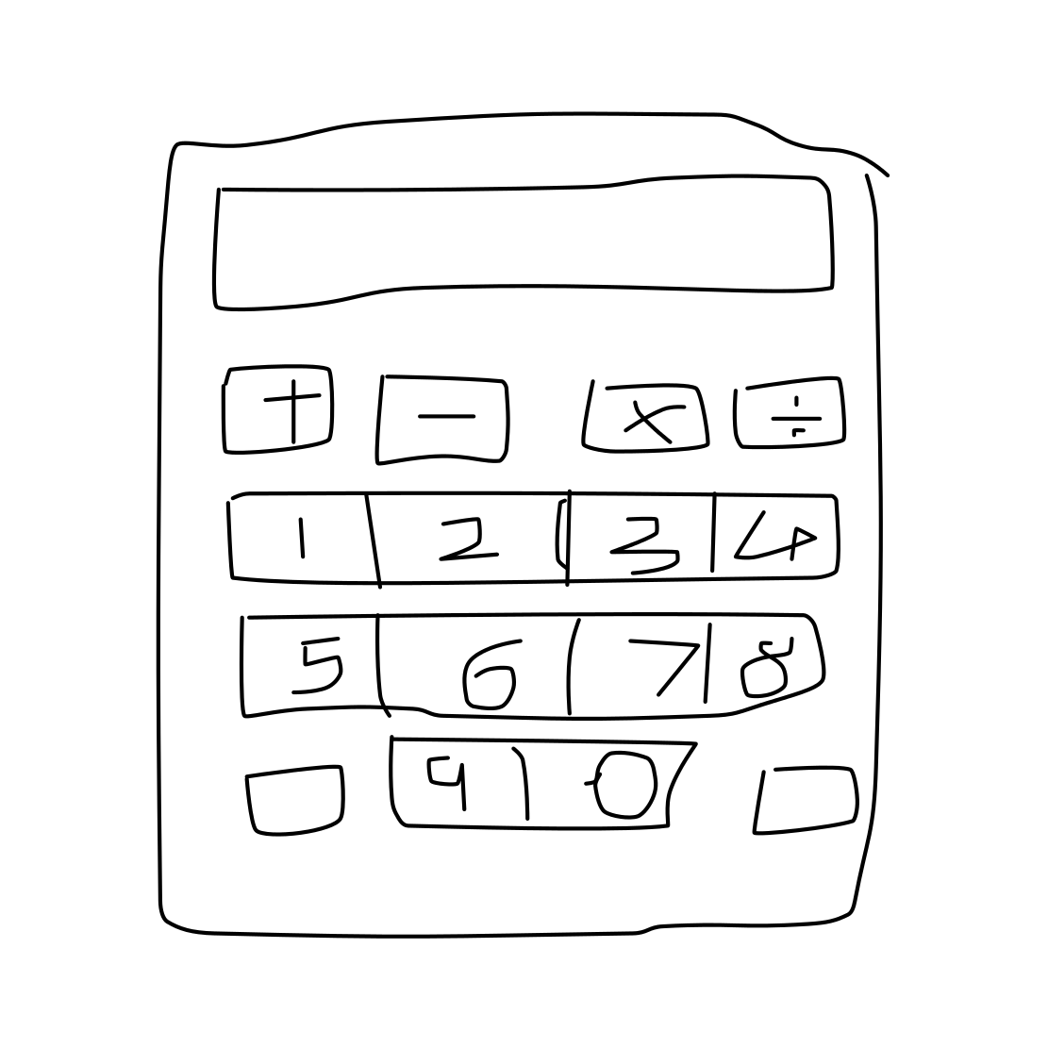
Class Calculator: mAP 0.65 Recall 0.85
Worst sketch: AP = 0.0131
Best sketch: AP = 0.8586
Some other sketches from the calculator class:

Slide 34
Worst mAP and Accuracy results
? =

Slide 35
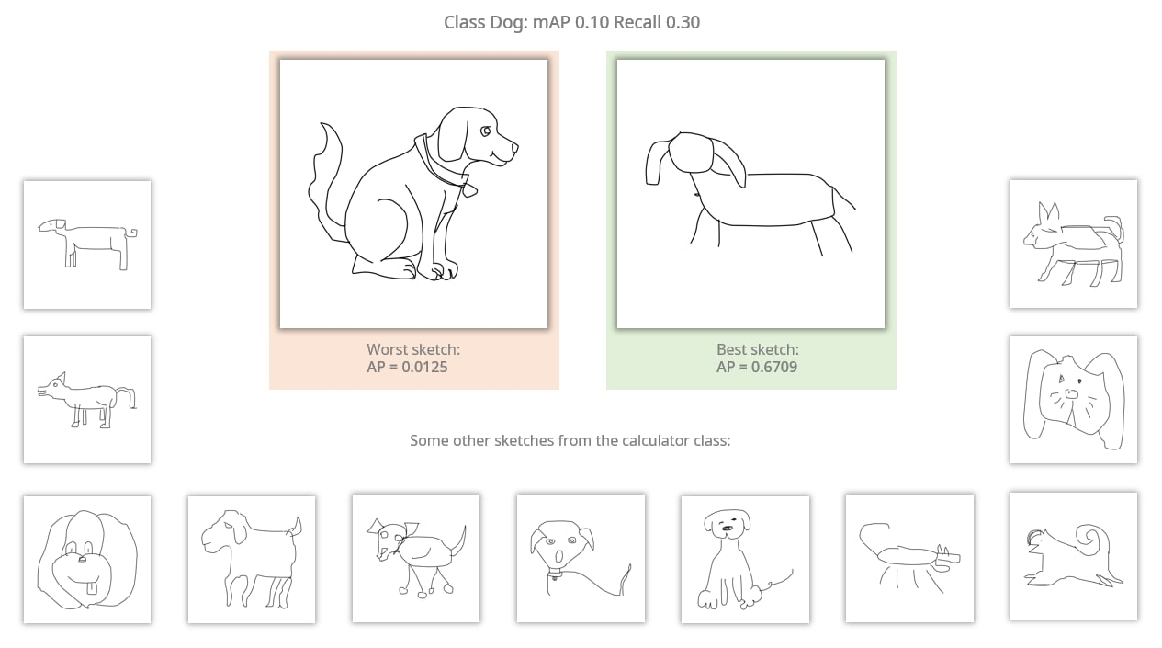

Slide 36
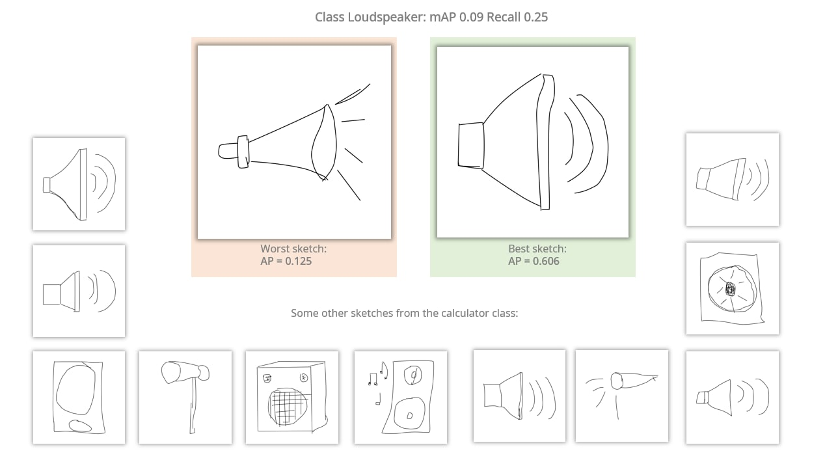

Slide 37
Most Frequent Misclassifications
?

Slide 38
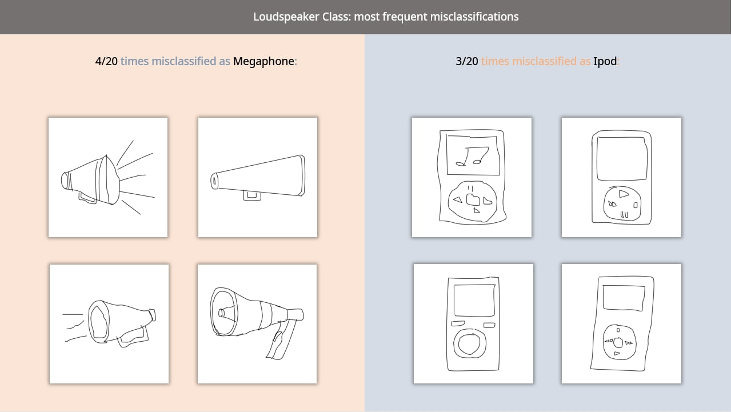

Slide 39
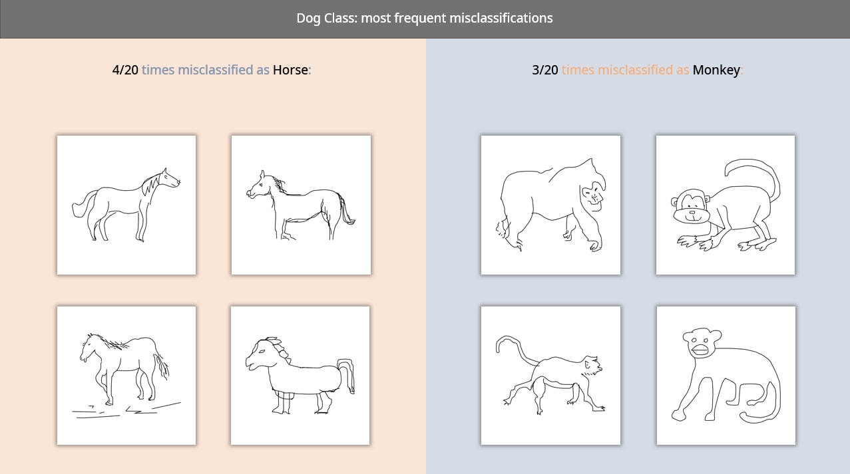

Slide 40



WEB Sketches Recognition Architecture
User
User Input
Web Interface
LSH Index
Output sketches

Slide 41
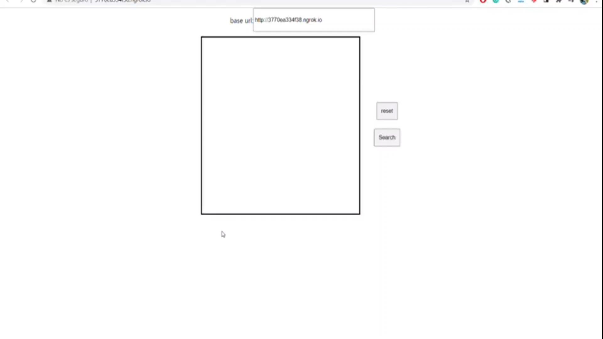
DEMO

Slide 42
Project Source Code
Analysis_By_Class
MIRCV
MIRCV_Functions
Pca_Try
accuracy_assessment
evaluate_models
lsh_finetuning
lsh_finetuning_bucket_dispersion
mAP_by_class
save_index
siamese_finetuning
sketches
web

Slide 43
RESOURCES
Papers
Rethinking the Inception Architecture for Computer Visual
A Neural Network for PCA and Beyond
Theory and Applications of b-Bit Minwise Hasing

Slide 44
THANKS!

